Slide 1
sdmay19-16
Android Application to Detect Texting while Driving
Team members: Kristina Robinson, Sara Mace, Andrew Knaack, Derek Clayton, Lucas Golinghorst, Ryan Baker
Client/Advisor: Daji Qiao
http://sdmay19-16.sd.ece.iastate.edu/
Notes:
Hi,
We are group SDMay19-16. Our project is an Android application that will detect texting while driving.

Slide 2
Project Plan - Problem Statement
Addresses the issue of texting while driving.
3 years ago, 391,000 injuries were caused by distracted driving accidents.
9 people are killed everyday from distracted driving accidents [1]. Answering texts while driving might seem harmless, but replying to a text message takes the driver’s eyes off of the road for at least a few seconds. It takes only three seconds of the driver having their eyes off of the road to be in a car crash.
Our solution is to build an android application to detect if someone is texting while driving.
Our goals include detecting whether someone is in the driver’s seat.
In order to do that without simply locking out everyone from their phones, our solution will have to include many different measures to ensure accurate detection.
[1] “100 Distracted Driving Facts & Statistics for 2018.” TeenSafe, 5 July 2018, www.teensafe.com/distracted-driving/100-distracted-driving-facts-and-statistics-2018/.
Notes:
Our project is aimed at directing the issue of texting while driving.
A study done 3 years ago, found out that 391,000 injuries are caused by distracted driving accidents
According to “100 distracted driving facts and statistics for 2018”, by TeenSafe, 9 people are killed every day from distracted driving accidents.
Sending a text might seem harmless but it takes the drivers eyes off the road for a few seconds at a minimum. TeenSafe states that it only takes 3 seconds of the driver not having their eyes on the road to be in a car crash
Our group has decided to build an android application that will detect if someone is sitting in the driver's seat and if they are texting.
We want to ensure that a passenger is still able to text we plan to have many different modules to ensure accurate detection.

Slide 3
Project Plan - Market Survey
AllState DriveWise Application
It tracks good driving habits including how fast a user is driving.
Can also text people who have texted the device while you are driving to let them know that you are driving and will respond later.
SafeDriveZone Application
Three separate applications (Parent, Driver, and its own Messenger)
Monitors average speed and current speed.
Also redirects in bound text messages, phone calls and silences notifications
Academic Research
University of Waterloo (Canada) has been working on an algorithm.
Used the camera attached to the dashboard to analyze head and face positioning
The algorithms were trained with machine learning
Notes:
The market is very vast on the solutions to help prevent texting and driving.
The first app that is aimed at preventing texting while driving is AllState’s DriveWise Application. This application tracks good driving habits. It can also text people who have texted the users phone to let them know that you are driving and will respond later. This application locks a passenger out of using their phone though which is a problem we want to solve.
The second app is SafeDriveZone Application. This is actually 3 separate applications. These applications are Parent, Driver, and its own messenger. This monitors average speed and current speed. It also redirects inbound text messages, and phone calls. It also silences all notifications. This app has some good features but we want to make a stand alone app, that anyone could use, even if they weren’t a teen.
Our group also looked at the market of what is currently being done in academic research. The University of Waterloo in Canada has been working on an algorithm to detect texting while driving. Their algorithm is using the camera on the phone to analyze head and face positioning. The algorithm has been trained with machine learning. Although, this is still in the academic world and no commercial applications are using this yet.

Slide 4
Project Plan - Project Milestones & Schedule
Milestones
Speedometer prototype
Completion of learning mode prototype
Completion of detection mode prototype
False positive and false negative rates at or below 50%
False positive and false negative rates at or below 10%
False positive: In this case, a false positive is our application incorrectly identifying a passenger as a driver and blocking their texting capabilities.
False negative: In this case, a false positive is our application incorrectly identifying a driver as a passenger and not blocking their texting capabilities.

Slide 5
Project Plan - Resource/Cost Estimate
Cost in time is broken down into 5 major tasks
1. Project setup/recording speed with accelerometer/creation of mode switching
65 total hours
2. Data collection during learning mode and then using data to determine user behavior
80 total hours
3. Data collection during detection mode and then being able to lock the user out
60 total hours
4. Improving learning and detection mode after initial tests
60 total hours
5. Final Improvements to learning and detection mode after extensive testing
30 total hours
Only financial cost is any fuel used during testing and data collection

Slide 6
Project Plan - Potential Risks & Mitigation
Physical health risk
Testing needs to be in a controlled environment so no team members get injured as well as anyone else
Minimize distraction for driver while other team members are testing
Scheduling risk
Over the course of 491 we have already had many team members get sick
Need to plan around team member illness so we can still get our work done on time
Could be crunched for time with our current schedule
Time to implement modules could take longer than estimated

Slide 7
Project Plan - Functional Requirements
Prevent phone user from sending texts if they are TWD.
False positive and false negative rates should not be greater than 10%.
Will run on Android Marshmallow (6.0) and newer.
The application will not be reliant on internet.
Exempt all Emergency Service Numbers.
Optional: Prevent phones from viewing texts.
Optional: Response time is fast enough to block the reading of incoming texts

Slide 8
Project Plan - Non Functional Requirements
The application will be easy to set up and run.
Application must consistently run at least 95% of the time without crashes.
Application must comply with applicable sensitive data laws.

Slide 9
Project Plan - Technical/Other Constraints/Considerations
Members cannot actually text and drive to test our application.
Testing with an actual car will require at least two people.
All team members lack experience with machine-learning.
This project is intended for research, not marketability.

Slide 10
System Design - Functional Decomposition
6 Modules
Speedometer
Texting Speed Tracker
Spelling Correctness Tracker
Phone Handling Tracker
Centripetal Acceleration
Camera
3 Important Pieces of Information
Is the user in a vehicle?
Is the user distracted or showing abnormal behaviors?
Is the user in the driver’s seat?
If all 3 important pieces of information are determined to be true from the 6 modules, then a “Phone Lock” will occur, preventing the user from texting (other phone operations not inhibited)

Slide 11
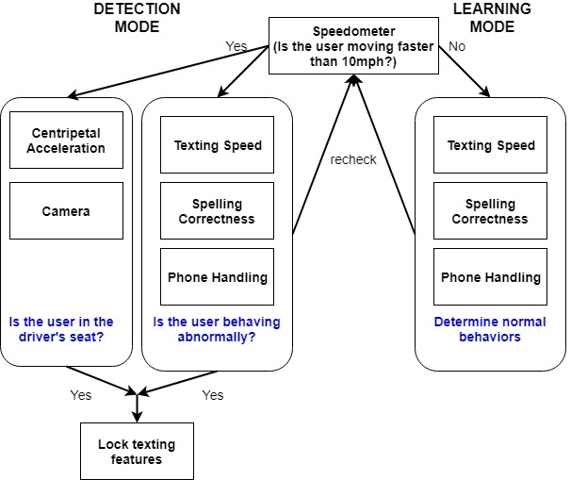
Conceptual Diagram:
Modes
and
Modules

Slide 12
System Design - Detailed Design
Based on built-in sensors
Speedometer - linear acceleration
Centripetal Acceleration - linear acceleration
Phone handling - magnet or gyroscope
Based on Software Listeners
Texting Speed - Textwatcher interface
Spelling Correctness - Spell Checker Session interface
Others
Camera - normal front/back phone cameras
Centripetal Acceleration - also uses GPS

Slide 13
Algorithms
Camera
Machine Learning (Supervised Learning)
Feed images of the inside of cars, algorithm learns what the car should look like from different perspectives (driver vs passenger areas)
Key items to look for: wheel, dashboard readings, seat belt, etc.
Texting Speed, Spelling, and Handling
Learning is separated into “sessions” between starting and sending text messages
Average speed, correctness, and handling positions are recorded long-term
New sessions take the old values and adjust them with new averages
Takes a few sessions to get reliable average

Slide 14
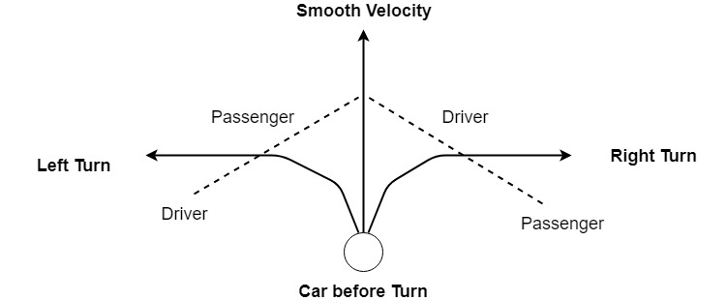
Algorithms, Cont.
Centripetal Acceleration
Smooth velocity provided by GPS
When turning, compare current acceleration to the last smooth velocity
Left Turn: acceleration being close to smooth velocity indicates user is passenger
Right Turn: acceleration being close to smooth velocity indicates user is driver

Slide 15
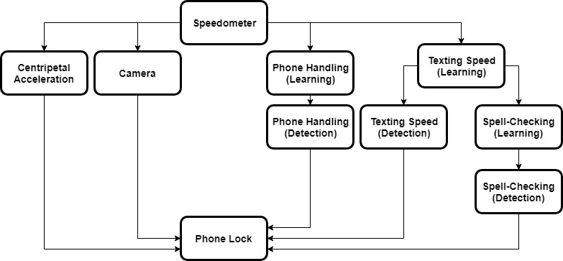
Module Dependencies Flowchart

Slide 16
System Design - Hardware/Software/Technology Platforms
Mobile Phone
Android Devices
v6.0 Operating System or newer
Built-in Sensors
Accelerometer - measures force of acceleration in the x, y, and z axis
Gyroscope - measures rate of rotation on the x, y, and z axis
Camera - captures front facing and back facing images
Personal Vehicle
4 Passenger Standard Vehicle
Used for field testing of modules

Slide 17
System Design - Hardware/Software/Technology Platforms
Android Studio IDE
Application framework tools
Compatible with Android mobile
phones
Open Source Library
-Textwatcher Interface
-SpellChecker Interface
Additional Software
OpenCV
Image processing, important features like face detection and object detection.
JUnit
Open source testing framework
Provides annotations, assertions, test runners
Mockito
Mocking Framework
Used for creating mock objects for unit testing

Slide 18
System Design - Test Plan
Acceptance - Testing of entire system based on the functional requirements.
System - Testing of entire system based on the non-functional requirements.
Integration - Testing of interaction points between the newly developed module and existing system.
Unit - Complete testing of a given module. Prototype will be made and tested for accuracy.

Slide 19
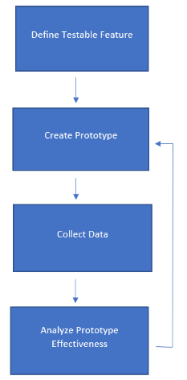
System Design - Prototype Implementations
1. Define Testable Feature
Choose one feature of solution to test
2. Create Prototype
Create low-res version of one solution to be tested
3. Collect Data
Run multiple test trials and collect results
4. Analyze Prototype Effectiveness
Run collected data against expected results

Slide 20
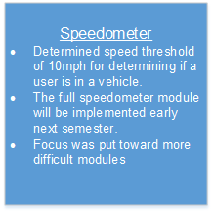
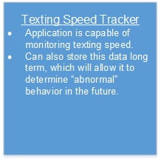
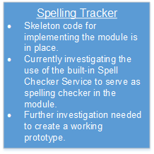
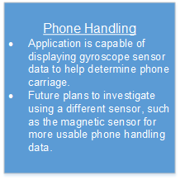
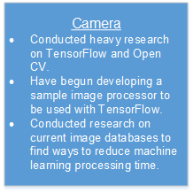
Conclusion - Current Project Status
Notes:
Corrections: Speedometer- Determined speed threshold of 10 mph for determining if in vehicle. Will be implemented next semester.
Breaking down the current status of our project into its individual modules, a lot of research and prototyping has been done across the board. We’ve implemented features into each module as we gather more research and conduct more tests. The Speedometer module was considered one of the easier modules to implement, so we worked on it earlier and it can do exactly what we want: determine if a person is in a vehicle based on the phone’s speed.
Furthermore, our texting speed tracker is active and can record user texting speeds. It’s companion, the spelling tacker is still in its very early stages, but with some more research on the android’s built-in spell checkers, we’re looking forward to great progress in the future.
Preleminary data on centripetal acceleration has been collected and it points to centripetal acceleration being a great indicator of which side of a vehicle the user is on. We’re currently investigating using the phones magnetic sensors for the phone handling module, as we noticed its readings were more significant than the gyroscope readings we were relying on earlier.
Our research into Tensorflow and OpenCV have led to the development of a sample image processor, which marks the start of developing the coding portion of the camera module. We’ve also looked into ways to minimize the time it takes the machine learning algorithm to process by investigating the use of image databases to help increase learning speed.
Of course, we would not have reached this current status without the contributions of our group members . . .

Slide 21
Conclusion - Task Responsibility/Individual Contribution
Each member had a role on the team.
Project Lead - Kristina
Meeting Scribe - Sara
Lead Designer - Andrew
Test Engineer - Lucas
Report Manager - Derek
Lead Architect - Ryan
We divided work on a module basis, different members assigned to different components
Speedometer - TBD
Texting Speed- Andrew
Phone Handling - Sara and Kristina
Spelling Tracker - Andrew
Camera - Lucas and Ryan
Centripetal Acceleration - Derek
Notes:
Initially, everyone worked on researching technologies/methods we could use to determine if a user was texting while driving. We found plenty of plausible techniques, but after applying our constraints, functional and non-functional requirements, we narrowed these technologies down to the six that form our modules. Once we solidified our modules, different group members were assigned to work on different modules. [Point out assignments here]. We expect these members to continue to work on these modules moving forward to next semester . . .

Slide 22
Conclusion - Plan for Next Semester
Fully implement modules
Camera: Implement efficient machine learning into camera module.
Centripetal Acceleration: Create an algorithm for handling centripetal acceleration readings
Phone Handling: Determine viability of magnetic sensor and ways to implement a machine learning algorithm for phone carriage.
Spell Tracker: Eliminate bugs and create a working spell tracker.
Get the application to run as a background process on the phone.
Develop a GUI for the application.
Create a phone lock mechanism that reads in the module data constantly to determine if the phone should be locked.
Notes:
A lot of this semester was dedicated to extensive research on usable technologies, machine learning, and sensor reading. We added some features to the app that display sensor readings, track texting speed, track speed, and stores said data. Next semester, we are leaving the research phase and delving into the creation the the app, fleshing out each module and ensuring its functionality as we piece the whole application together. Some of those tasks we’ve written here, including working on our image processing machine learning algorithm, creating an algorithm to handle centripetal acceleration calculations, finalize the sensor we’re going ot use for phone handling, and eliminating the bugs in our spell tracker. We also plan on figuring out how to get the process to run in the background rather than the foreground, and it will need to have its own GUI. We will create a phone lock mechanism as well.

Slide 23
Questions?

